Slide 1



FIRE SAFETY FOR OLDER ADULTS

Slide 2


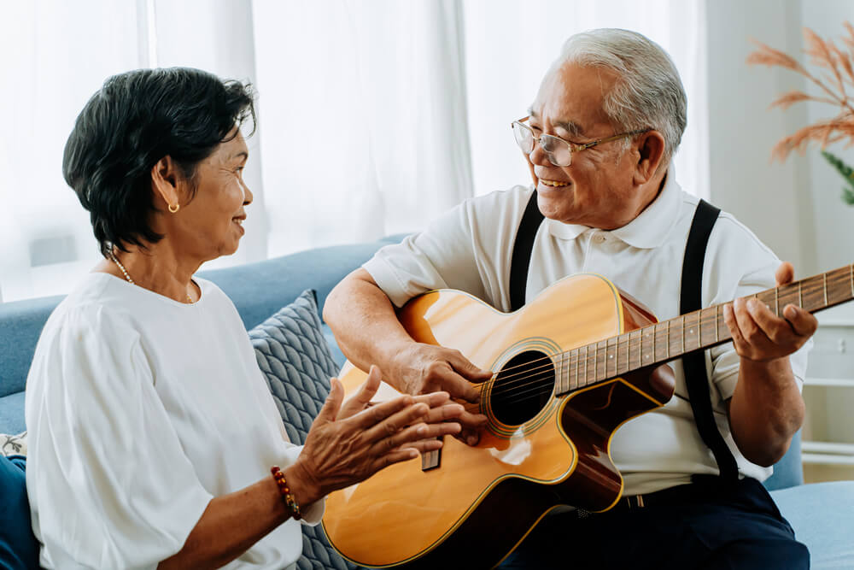

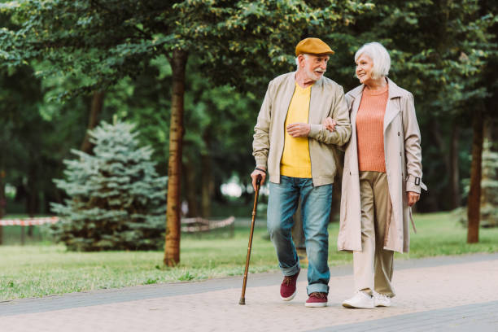
AS WE GROW OLDER

Slide 3


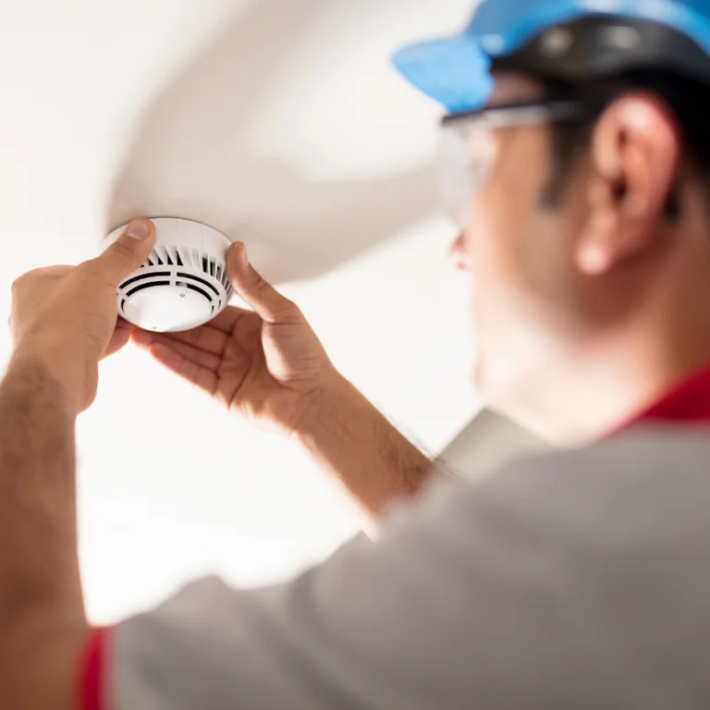
SMOKE ALARMS
  Put working smoke alarms on every level of your home, inside bedrooms and outside sleeping areas.
  Replace the entire smoke alarm every 10 years or sooner if it does not sound when you push the test button.

Slide 4
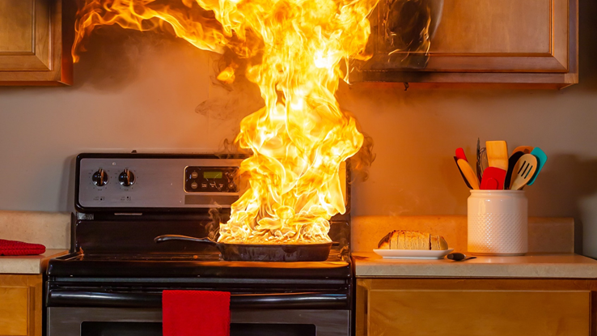
FIRE SAFETY IN THE KITCHEN
  Stay in the kitchen when you are cooking.
  Use a timer to remind you that you are cooking.
  Keep a pot lid nearby when you cook, to cover fire.
  Keep anything that can burn away from the stove top.

Slide 5
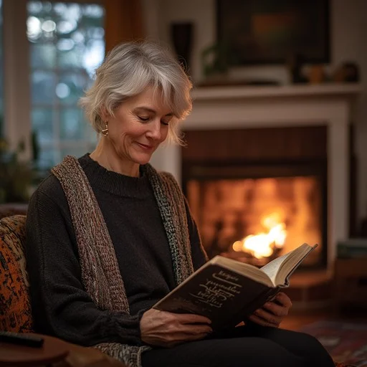
HEAT YOUR HOME SAFELY
  Make sure all fuel-burning equipment is safely vented to the outside to avoid carbon monoxide (CO) poisoning.
  Install CO alarms, especially if your home is heated by any source other than electricity.
  Have only a qualified professional install and inspect your heating equipment.

Slide 6
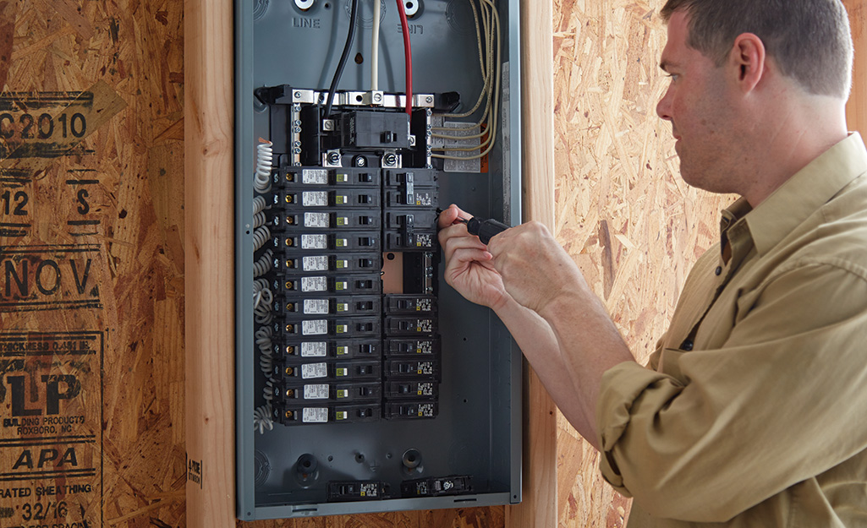
PRACTICE ELECTRICAL
SAFETY
  Have a licensed electrician check your electrical system if you have frequent blown fuses or tripped circuit breakers.
  Avoid using extension cords for permanent wiring.
  Check your electrical appliances. Replace the appliance if the electrical cords are cracked, damaged or loose.

Slide 7
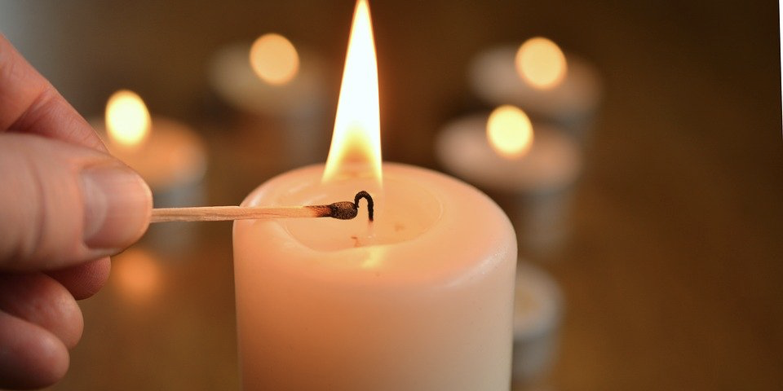
CANDLE SAFETY
  Only burn candles when you are in the room.
  Protect candle flames with glass chimneys or containers.
  Never use a candle where medical oxygen is being used.
  Keep candles at least 12 inches away from anything combustible.

Slide 8

PLAN YOUR ESCAPE
  Plan your escape around your abilities.
  Clear all clutter that may block your escape route or make you trip or fall.
  Keep eyeglasses, keys, hearing aids and a phone within reach next to your bed.
  Have a designated spot to meet.

Slide 9
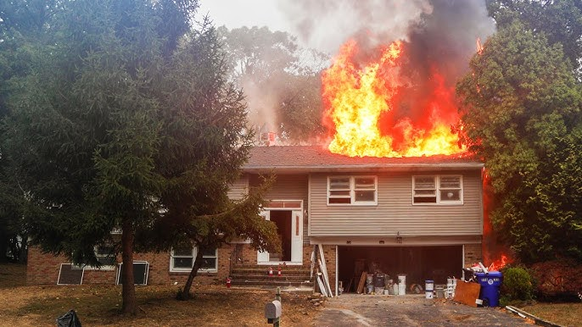
WHAT TO DO IF YOU HAVE A FIRE
  Stay calm when the smoke alarm sounds.
  Get out fast and stay out. Never go back inside for people, pets or things.
  Call 911

Slide 10
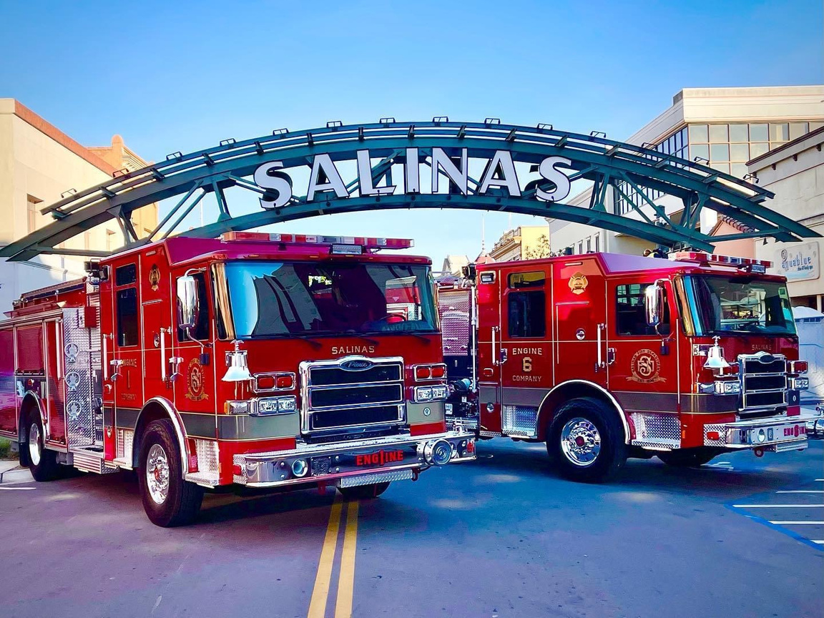




THANK YOU FOR YOU ATTENTION
Any Questions?
831-758-7466
FirePrevention@ci.salinas.ca.us
Salinas Fire Prevention
200 Lincoln Ave, Salinas, CA 93901

